Slide 1
Object Oriented Programming
Abeer GAUHER
Email: abeer.gauher@nu.edu.pk
Office: CS BASEMENT 2, Office number 23

Slide 2
Diamond Problem
class A
{
public:
A() { cout << "A's constructor called" << endl; }
};
class B
{
public:
B() { cout << "B's constructor called" << endl; }
};
class C: public B, public A // Note the order
{
public:
C() { cout << "C's constructor called" << endl; }
};
int main()
{
C c;
return 0;
}
Multiple Inheritance: where a class can inherit from more than one classes.
The constructors of inherited classes are called in the same order in which they are inherited. For example, in the following program, B’s constructor is called before A’s constructor.
The destructors are called in reverse order of constructors.

Slide 3
Diamond Problem
The diamond problem occurs when two superclasses of a class have a common base class. For example, in the following diagram, the TA class gets two copies of all attributes of Person class, this causes ambiguities

Slide 4
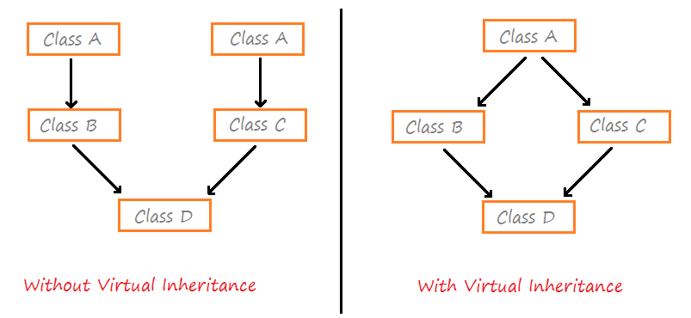
Diamond Problem

Slide 5
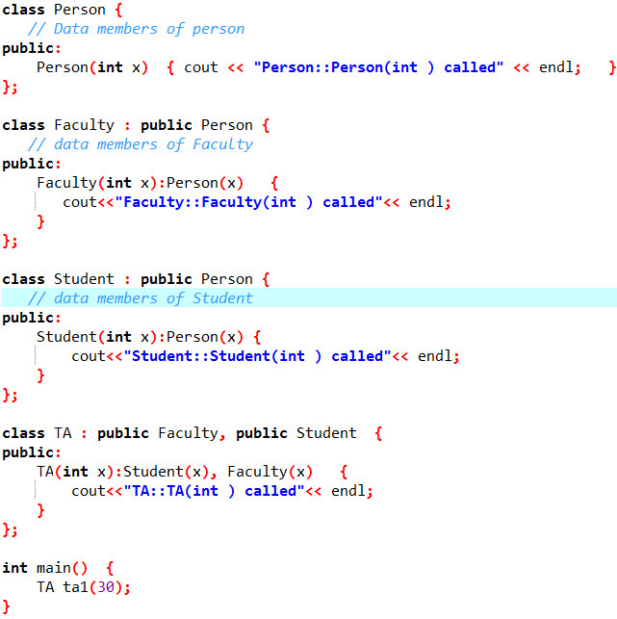

Diamond Problem
Constructor of ‘Person’ is called two times. Destructor of ‘Person’ will also be called two times when object ‘ta1’ is destructed.
So object ‘ta1’ has two copies of all members of ‘Person’, this causes ambiguities.
The solution to this problem is ‘virtual’ keyword.

Slide 6
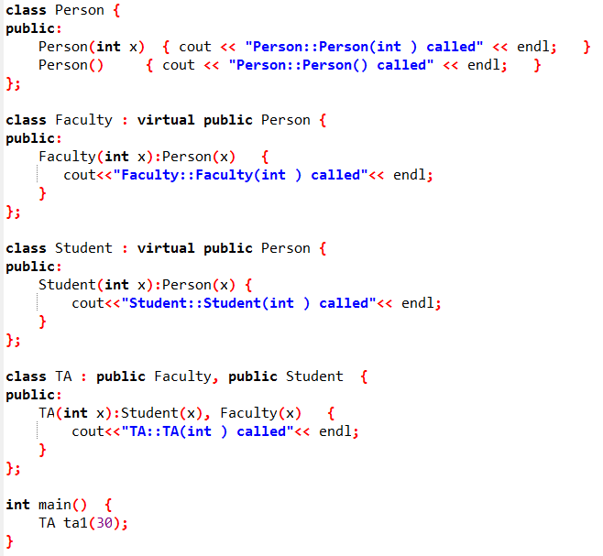

Diamond Problem
Constructor of ‘Person’ is called once. One important thing to note in the above output is, the default constructor of ‘Person’ is called.
When we use ‘virtual’ keyword, the default constructor of grandparent class is called by default even if the parent classes explicitly call parameterized constructor.

Slide 7
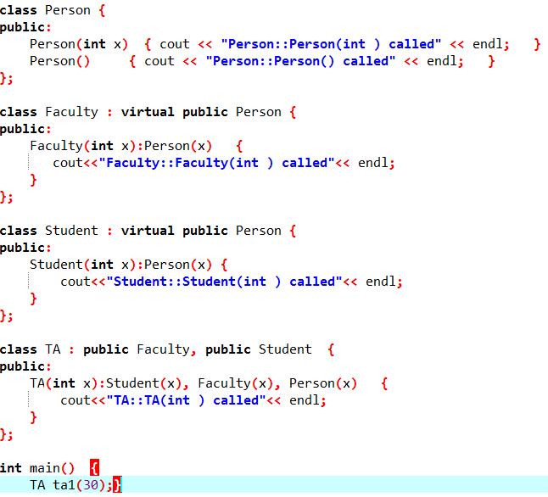

Diamond Problem
How to call the parameterized constructor of the ‘Person’ class? The constructor has to be called in ‘TA’ class. For example, see the following program.
In general, it is not allowed to call the grandparent’s constructor directly, it has to be called through parent class. It is allowed only when ‘virtual’ keyword is used.

Slide 8
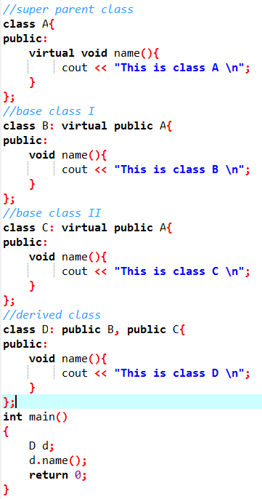
Diamond Problem

Slide 9
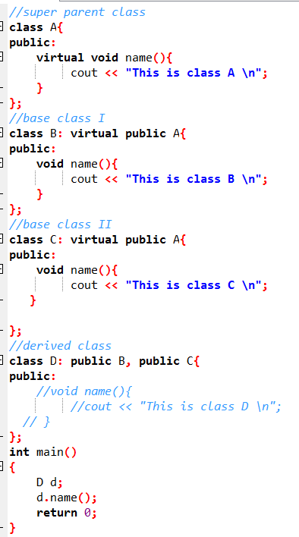
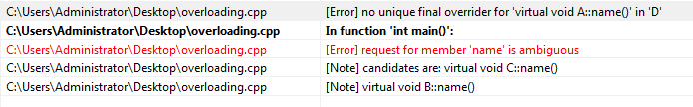
Diamond Problem

Slide 10
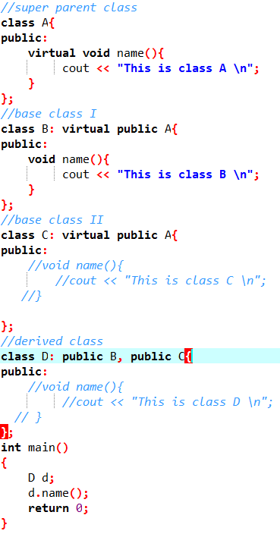

Diamond Problem
If a function exists in ClassB but not in ClassC then, function of ClassB is called.

